Slide 1
SECURE VIDEO TRANSMISSION USING DOT-BASED ENCRYPTION
Faculty Guid
Mrs. Gowri M.CA, M.Phil., SET.,
Praveen Kumar .M
22124039

Slide 2
ABSTRACT :
Dot-based encryption is a novel approach to secure video transmission. It converts video frames into dot representations, obscuring pixel information. This method provides robust security against unauthorized access. It also minimizes computational overhead, making it efficient. The encryption and decryption processes are lightweight and fast. Experimental results show the method's effectiveness in maintaining video integrity. It outperforms traditional encryption techniques in speed and resource utilization. This approach enables secure and efficient video transmission in various applications.

Slide 3
INTRODUCTION :
Secure video transmission using dot-based encryption is a innovative approach that utilizes visual cryptography techniques to protect sensitive video content from unauthorized access. By dividing video frames into tiny dots, which are then encrypted using various algorithms, this method ensures that even if an unauthorized party gains access to the transmission, they will only see a collection of meaningless dots, rather than the original video content.

Slide 4
EXISTING SYSTEM :
The current system for video transmission employs a traditional encryption method, such as Advanced Encryption Standard (AES), to secure video data. However, this approach has several limitations. The computational overhead of AES encryption leads to reduced performance and delayed transmission, making it unsuitable for real-time video transmission. Furthermore, AES is vulnerable to brute-force attacks and key compromise, which can compromise the security of the video data.
Additionally, the encryption process can degrade the original video quality, resulting in a poor viewing experience

Slide 5

DRAWBACKS:
High Computational Overhead
AES encryption leads to reduced performance and delayed transmission.
Video Quality Degradation
Encryption process can degrade the original video quality.
Limited Scalability
Requires significant resources, making it unsuitable for large-scale video transmission.
High Latency
Unsuitable for real-time video transmission due to high latency

Slide 6
PROPOSED SYSTEM :
The proposed system ensures secure video transmission over insecure channels, guaranteeing the confidentiality and security of video content. Its scalable design allows it to handle large-scale video transmission applications, and it can be easily integrated with existing video transmission infrastructure.
the system supports various video formats and resolutions, making it adaptable for different devices and platforms. A secure key management system ensures authorized access to video content, completing the proposed system's robust security features. Overall, the proposed system offers a reliable and efficient solution for secure video transmission

Slide 7
Benefits :
Maintains Original Video Quality
Real-time Transmission
Efficient Key Management
Low Computational Overhead
Robust Security
The dot-based encryption technique provides robust security, ensuring that video content is protected from unauthorized access.

Slide 8


Normal Video
Project Demo :

Slide 9

Encrypted Video
Project Demo :

Slide 10
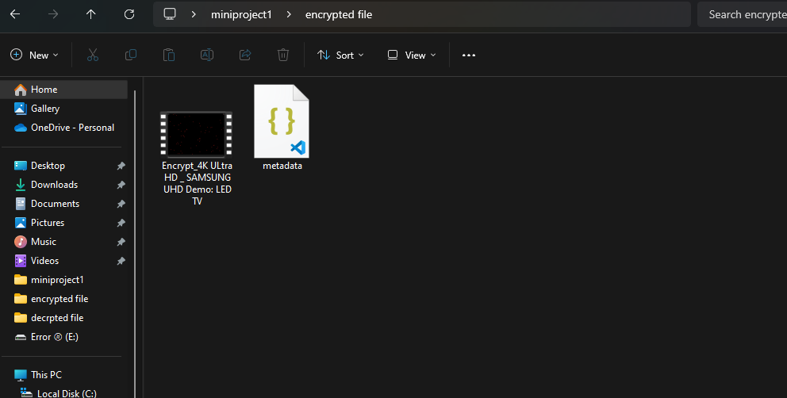
Project Demo :

Slide 11
Decrypted Video
Project Demo :

Slide 12
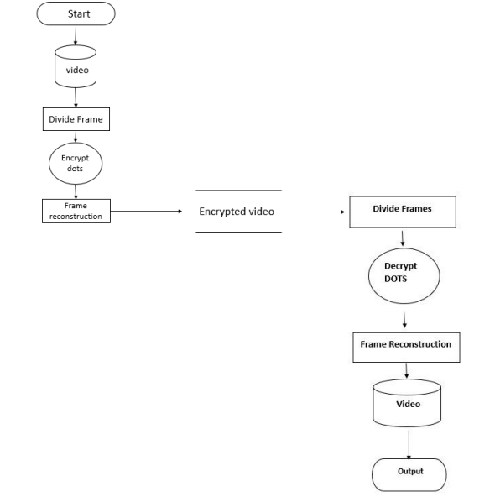
DATA FLOW DIAGRAM

Slide 13
Conclusion :
The Secure Video Transmission using Dot-based Encryption project has achieved a significant milestone in the development of a robust and efficient system for protecting video content in transit. By leveraging the innovative approach of dot-based encryption, the project has demonstrated a novel solution for ensuring video privacy and security, addressing a critical need in various industries. The system's architecture has been carefully crafted to balance security with performance, enabling efficient transmission and decryption of video feeds in real-time.The project's outcome has far-reaching implications for various applications, including surveillance, healthcare, financial services, and more. In surveillance, secure video transmission can protect sensitive areas and prevent unauthorized access to video feeds. In healthcare, secure video transmission can enable remote consultations and monitoring while maintaining patient confidentiality. In financial services, secure video transmission can facilitate secure video conferencing and data sharing.

Slide 14
Thank you

